Slide 1
Getting started
Lesson 4: Vector graphics

Slide 2
Objectives
In this lesson, you will learn:
the features of vector graphics
vector graphic file types
how to create vector graphic style images.

Slide 3
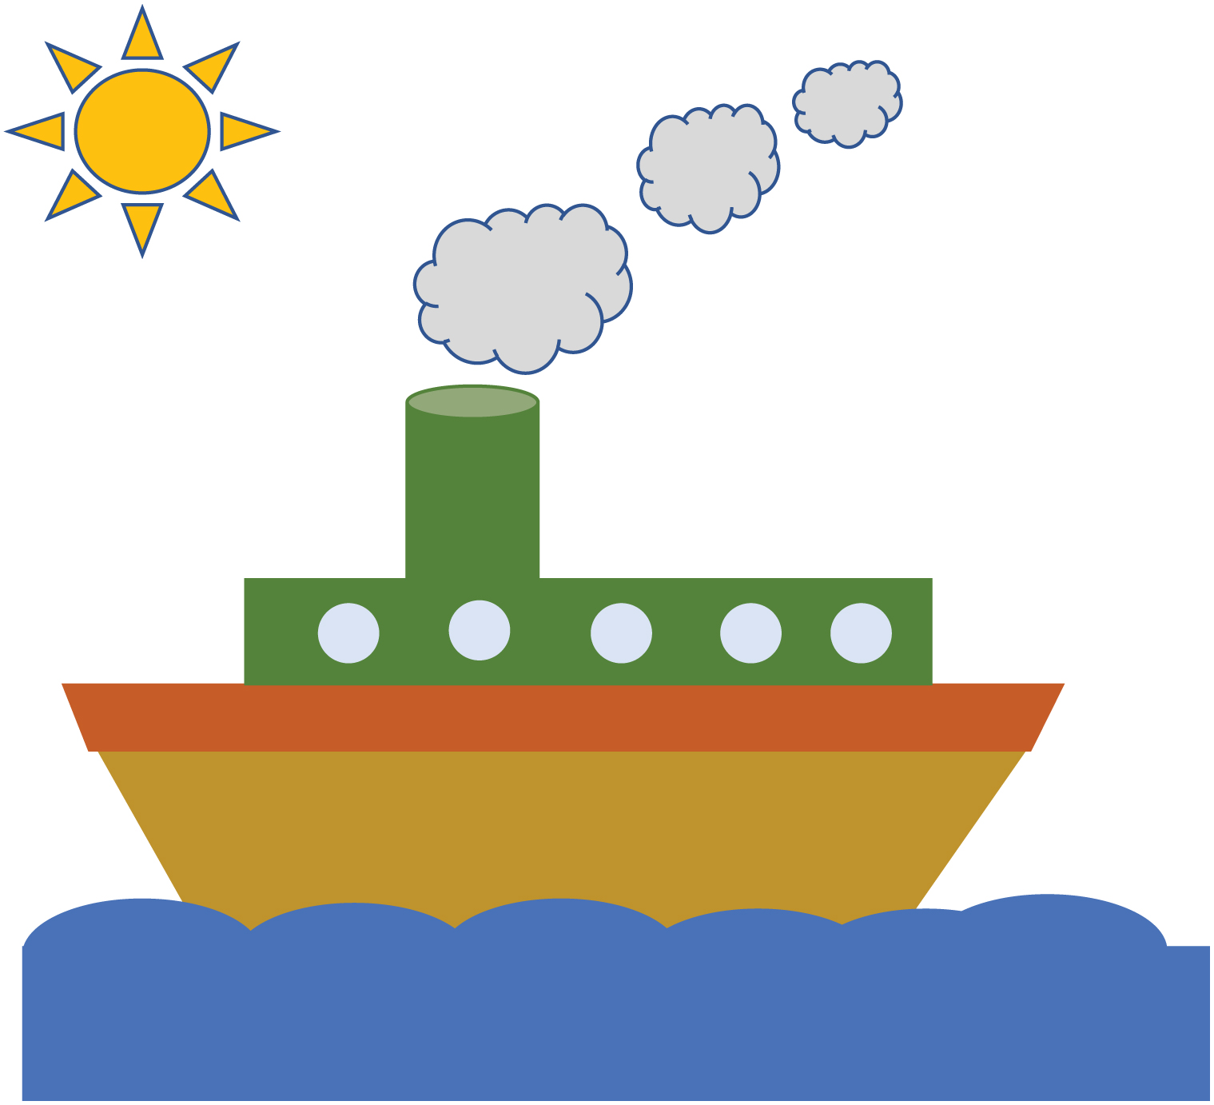

Slide 4
Vector graphics
Vector graphics are stored as a list of attributes.
Larger pictures are made up of shapes called objects, and the attributes for each object are stored separately.
The attributes include information such as the object’s:
height
width
x and y coordinates for the points
outline colour
line width
fill colour.
The shape of the object is stored as a set of points, and these are connected together by lines. So, for example, the coordinates of the three corners of a triangle are stored.

Slide 5
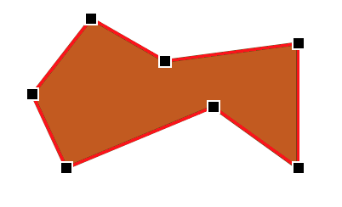

Editing vector graphics
Each object and its attributes can be edited independently.
Objects can be re-sized by clicking and dragging on the points.
The colour and line width can be changed using formatting options.
It is possible to layer objects to create a sense of depth or more complex shapes.
Vector graphics are scalable. This means that they can be enlarged without any loss in quality.

Slide 6
Vector graphic files
Even if an object in a vector graphic is quite large, it only uses a small amount of memory because the image is recreated from the attributes.
Therefore, the file size of a vector graphic is often quite small.
Common vector graphic formats are:
.eps: Encapsulated PostScript File
.svg: Scalable Vector Graphics File

Slide 7
Drawing vector-style graphics
It is possible to create vector-style graphics in a Word document using ‘Shapes’ on the ‘Insert tab’, or in Google Docs using the ‘Drawing’ tools on the ‘Insert’ tab.
Each shape, or object, is inserted and edited in turn.
Objects can be layered or can be grouped together to make it easier to re-size or move them.
Now watch Video 4.1

Slide 8

Activity 4.1: Vector graphic pictures

Slide 9
Quiz 4

